Slide 1
Android - Event Handling
Events are a useful way to collect data about a user's interaction with interactive components of Applications.
The Android framework maintains an event queue as first-in, first-out (FIFO) basis.
You can capture these events in your program and take appropriate action as per requirements.

Slide 2
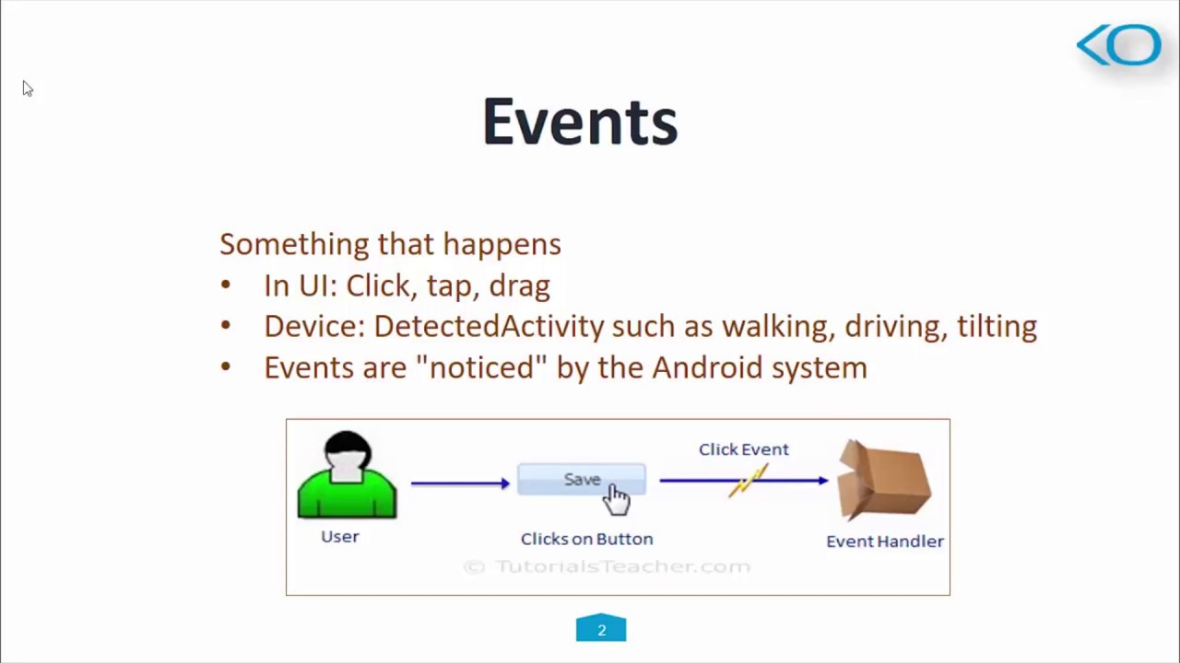
Event Handling

Slide 3
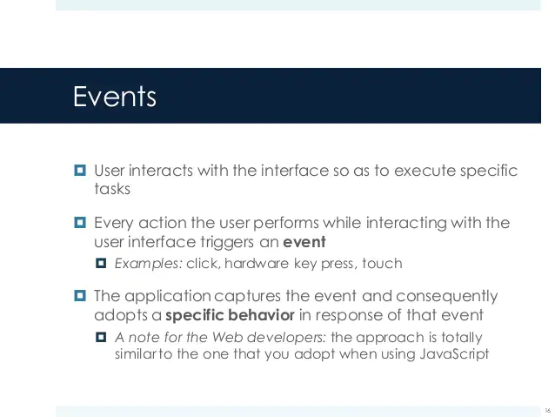
Event Handling

Slide 4
The user interacts with an app by touching, clicking, swiping or typing something.
The Android framework captures, stores, processes and sends these actions to the app as event objects.
The diagram (figure 1) below summarizes these interactions

Slide 5
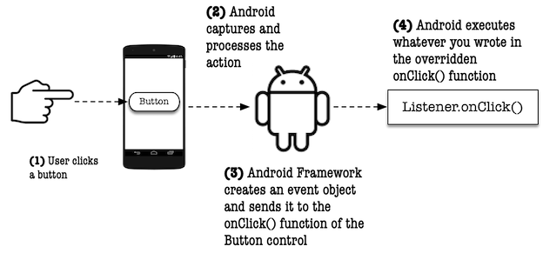

Slide 6
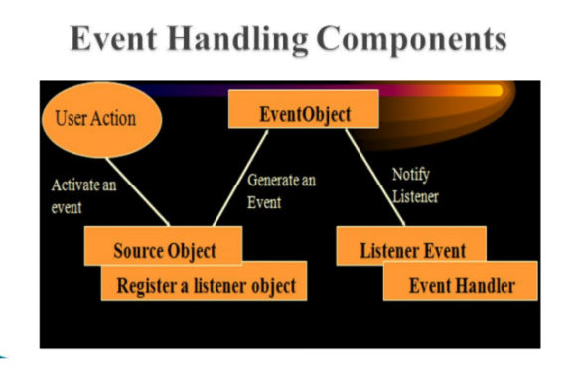
Components

Slide 7
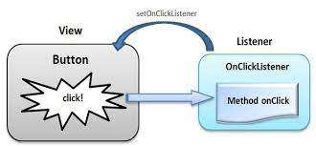

Slide 8
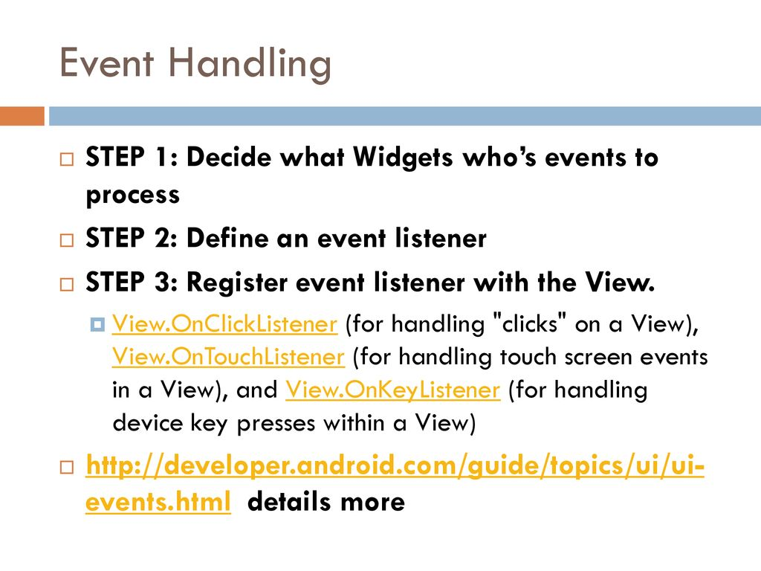

Slide 9
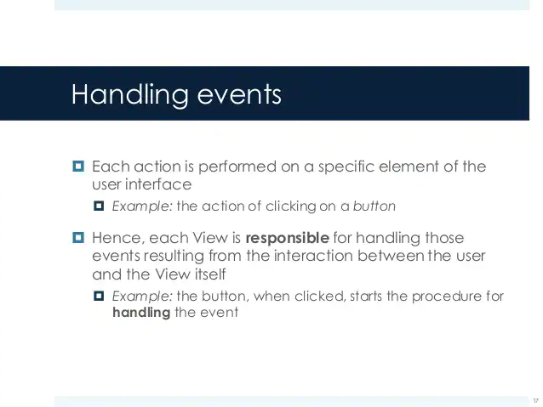

Slide 10
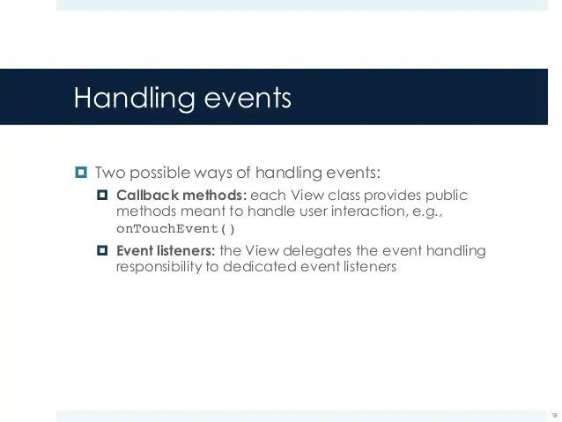

Slide 11
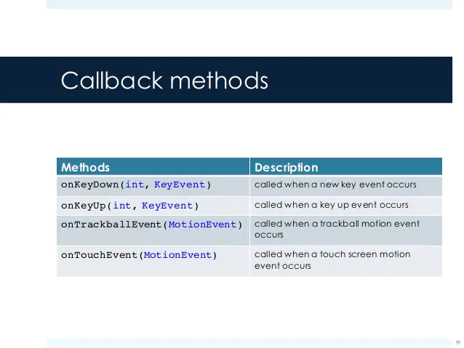

Slide 12
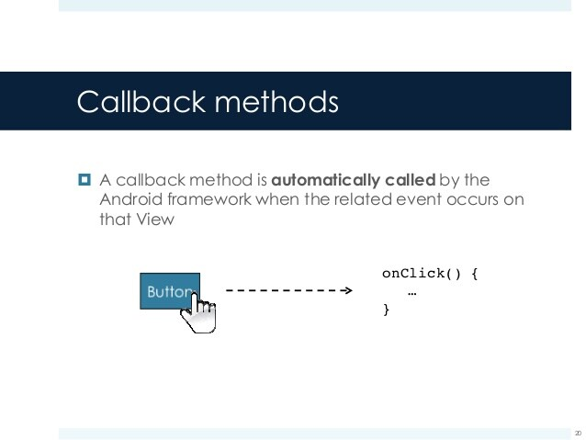

Slide 13
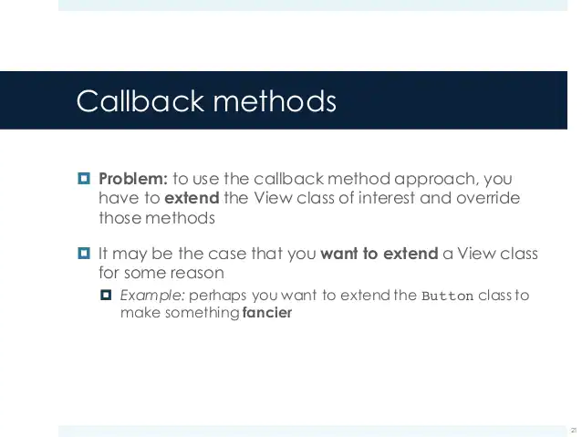

Slide 14
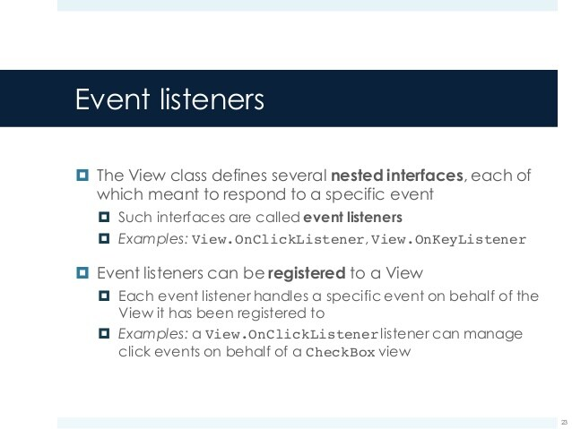

Slide 15
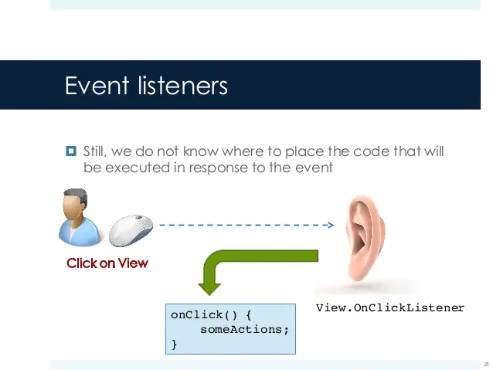

Slide 16
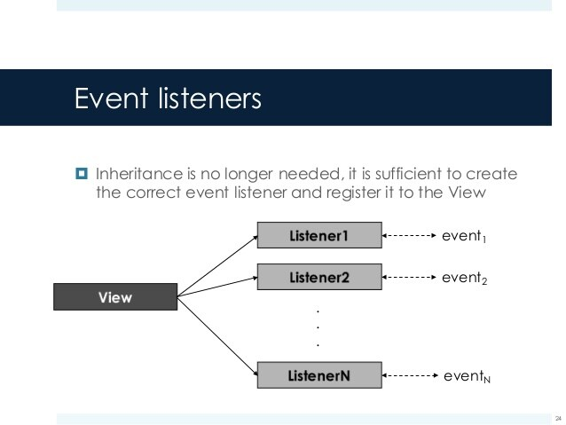

Slide 17
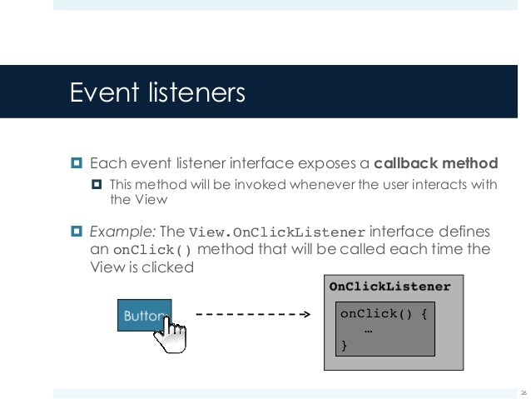

Slide 18
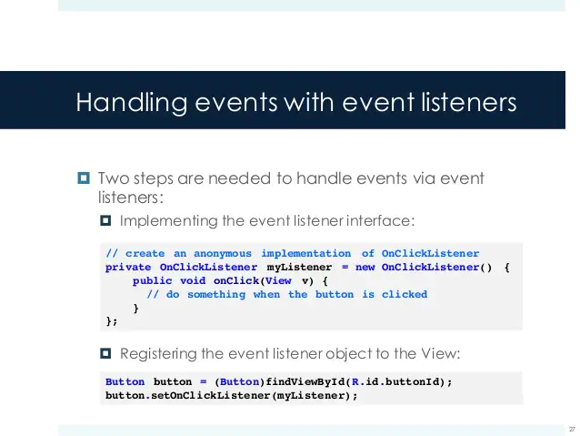

Slide 19
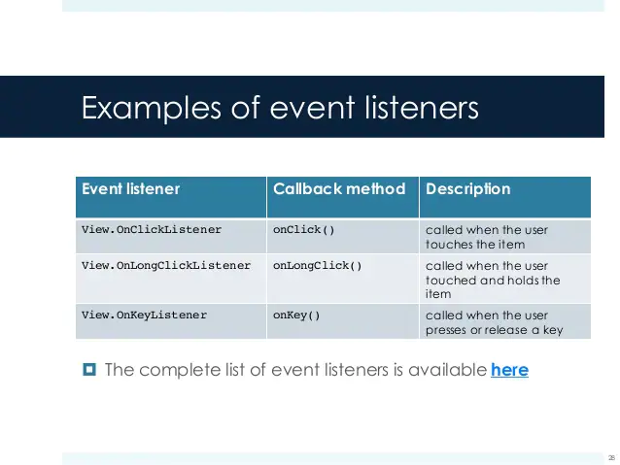

Slide 20
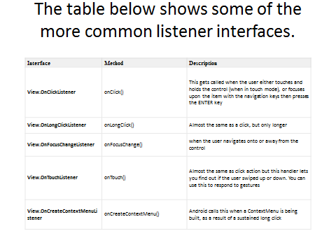

Slide 21
You can make the app respond these to events by doing the following:
Create a listener object that’s appropriate for the event you want the app to react to; if you want to respond to a click event, then use an the OnClickListener object. If you want to react to long clicks, you can use OnLongClickListener
Override the abstract methods of the listener. In case of the OnClickListener, the abstract method you need to override is the onClick() method
Bind the listener object to a View object, like a Button; Figure 2 shows an annotated diagram on how this might look in code

Slide 22
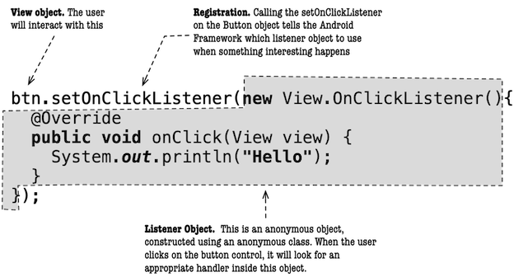

Slide 23
Assuming that in your project, you already have a Button object id of which is button, the following code gets a reference to the Button object
Button btn = (Button) findViewById(R.id.button);
Next, we can create a listener object and bind the Button (btn) to that listener object, like this
btn.setOnClickListener(new View.OnClickListener(){
@Override
public void onClick(View view) {
// statement;
}
});
The onClick() method, as shown in the code above, will be called whenever btn is clicked by the user; that’s where you should put program logic.
View objects, like Buttons, can be bound to other listeners

Slide 24
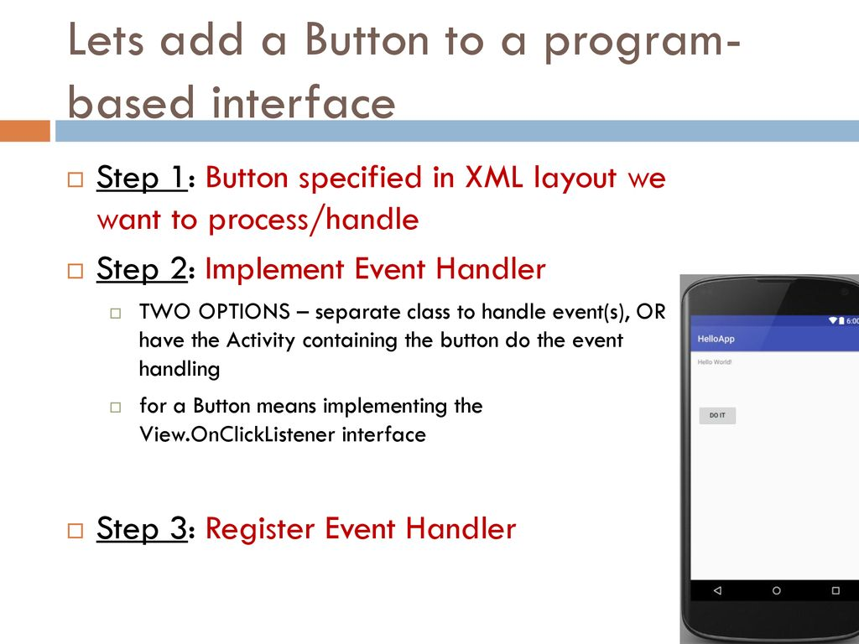

Slide 25
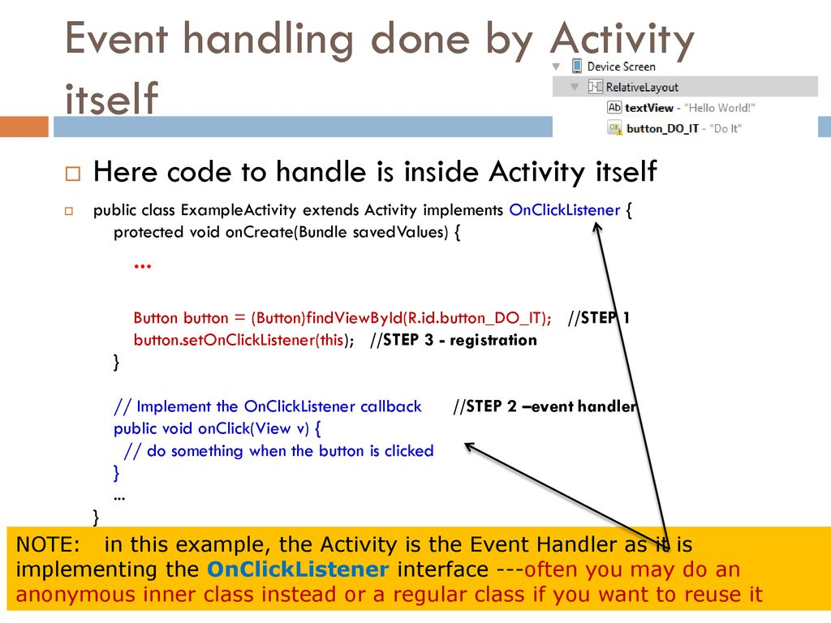

Slide 26
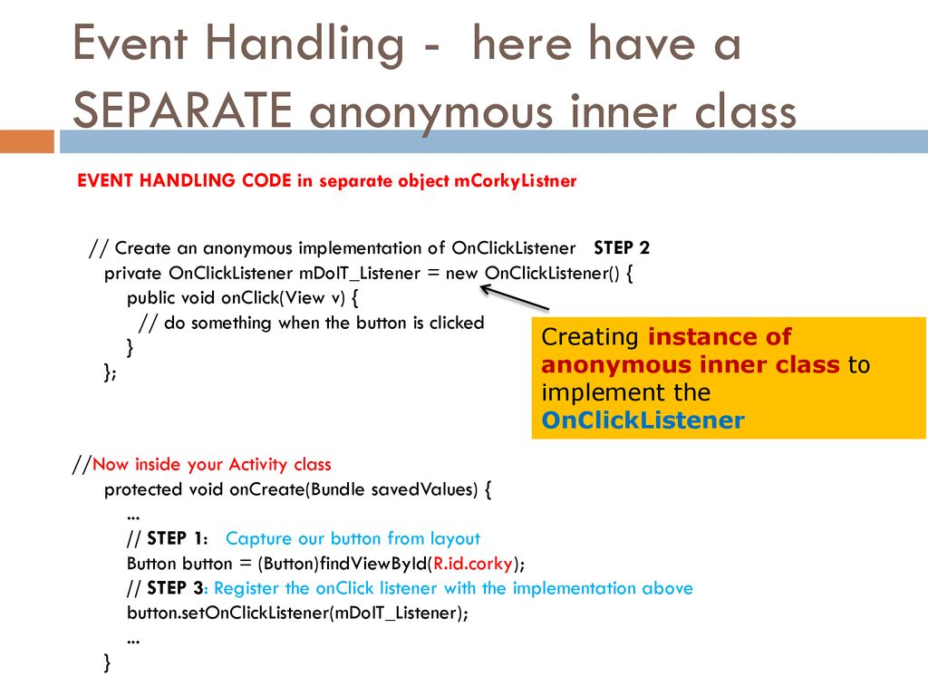

Slide 27
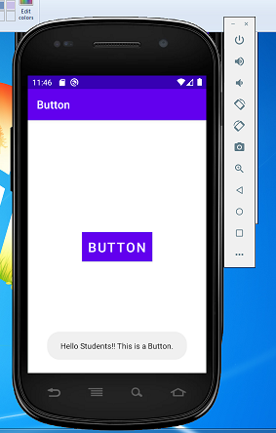

Slide 28
Activity_main.xml
<?xml version="1.0" encoding="utf-8"?> <androidx.constraintlayout.widget.ConstraintLayout xmlns:android="http://schemas.android.com/apk/res/android" xmlns:app="http://schemas.android.com/apk/res-auto" xmlns:tools="http://schemas.android.com/tools" android:layout_width="match_parent" android:layout_height="match_parent" tools:context=".MainActivity"> <EditText android:id="@+id/editTextTextPersonName" android:layout_width="wrap_content" android:layout_height="wrap_content" android:layout_marginTop="100dp" android:layout_marginEnd="25dp" android:ems="10" android:inputType="textPersonName" android:text="Enter User Name" app:layout_constraintEnd_toEndOf="parent" app:layout_constraintHorizontal_bias="1.0" app:layout_constraintStart_toEndOf="@+id/textView2" app:layout_constraintTop_toTopOf="parent" /> <TextView android:id="@+id/textView2" android:layout_width="105dp" android:layout_height="21dp" android:layout_marginStart="64dp" android:layout_marginTop="108dp" android:text="Username" app:layout_constraintStart_toStartOf="parent" app:layout_constraintTop_toTopOf="parent" /> <TextView android:id="@+id/textView3" android:layout_width="101dp" android:layout_height="33dp" android:layout_marginStart="52dp" android:layout_marginTop="40dp" android:text="Password" app:layout_constraintStart_toStartOf="parent" app:layout_constraintTop_toBottomOf="@+id/textView2" /> <EditText android:id="@+id/editTextTextPersonName2" android:layout_width="wrap_content" android:layout_height="wrap_content" android:layout_marginTop="24dp" android:layout_marginEnd="24dp" android:ems="10" android:inputType="textPersonName" android:text="Enter Password" app:layout_constraintEnd_toEndOf="parent" app:layout_constraintHorizontal_bias="0.988" app:layout_constraintStart_toEndOf="@+id/textView3" app:layout_constraintTop_toBottomOf="@+id/editTextTextPersonName" /> <Button android:id="@+id/button" android:layout_width="wrap_content" android:layout_height="wrap_content" android:layout_marginStart="64dp" android:layout_marginTop="72dp" android:text="SUBMIT" app:layout_constraintBottom_toBottomOf="parent" app:layout_constraintStart_toStartOf="parent" app:layout_constraintTop_toBottomOf="@+id/textView3" app:layout_constraintVertical_bias="0.073" /> <Button android:id="@+id/button2" android:layout_width="wrap_content" android:layout_height="wrap_content" android:layout_marginStart="60dp" android:layout_marginTop="64dp" android:text="CANCEL" app:layout_constraintBottom_toBottomOf="parent" app:layout_constraintEnd_toEndOf="parent" app:layout_constraintHorizontal_bias="0.307" app:layout_constraintStart_toEndOf="@+id/button" app:layout_constraintTop_toBottomOf="@+id/editTextTextPersonName2" app:layout_constraintVertical_bias="0.064" /> </androidx.constraintlayout.widget.ConstraintLayout>

Slide 29
Mainactivity.java
package com.example.eventhandling; import androidx.appcompat.app.AppCompatActivity; import android.content.Context; import android.os.Bundle; import android.view.View; import android.widget.Button; import android.widget.Toast; public class MainActivity extends AppCompatActivity { @Override protected void onCreate(Bundle savedInstanceState) { super.onCreate(savedInstanceState); setContentView(R.layout.activity_main); // storing ID of the button // in a variable Button button=(Button)findViewById(R.id.button); Button btn2=(Button)findViewById(R.id.button2); // operations to be performed // when user tap on the button if (button != null) { button.setOnClickListener((View.OnClickListener)(new View.OnClickListener() { public final void onClick(View it) { // displaying a toast message Toast.makeText((Context) MainActivity.this, R.string.message, Toast.LENGTH_LONG).show(); } })); btn2.setOnClickListener((View.OnClickListener)(new View.OnClickListener() { public final void onClick(View it) { // displaying a toast message Toast.makeText((Context) MainActivity.this, R.string.message1, Toast.LENGTH_LONG).show(); } })); } } }

Slide 30
Strings.xml
<resources> <string name="app_name">Event handling</string> <string name="btn">Button</string> <string name="message">Hello Students!! This is a Button.</string> <string name="btn2">btn2</string> <string name="message1">The event has been cancelled</string> </resources>

Slide 31
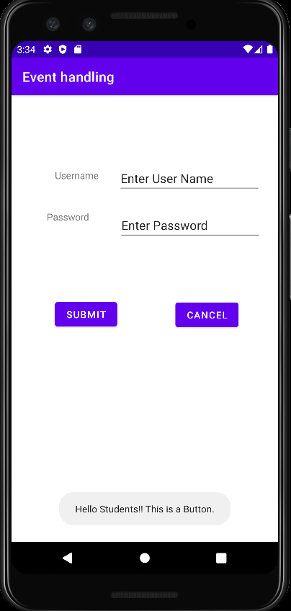
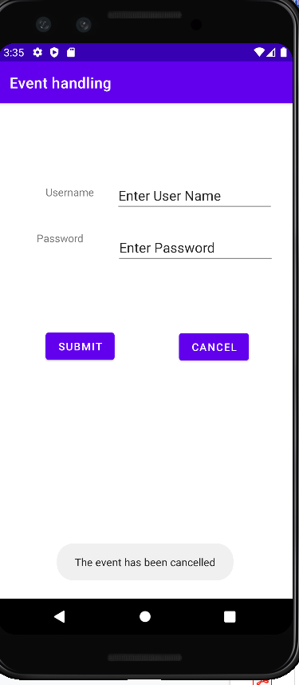
Example
Submit
Cancel

Slide 32
btn2
<?xml version="1.0" encoding="utf-8"?>
<LinearLayout xmlns:android="http://schemas.android.com/apk/res/android"
android:layout_width="match_parent"
android:layout_height="match_parent"
android:orientation="vertical" >
<TextView
android:id="@+id/textView2"
android:layout_width="wrap_content"
android:layout_height="wrap_content"
android:layout_centerHorizontal="true"
android:layout_marginLeft="100dp"
android:text="BMSCEE"
android:textSize="50dp" />
<Button
android:id="@+id/btnClick"
android:layout_width="wrap_content"
android:layout_height="58dp"
android:layout_marginLeft="150dp"
android:layout_marginTop="100dp"
android:text="Click Event" />
<Button
android:id="@+id/btnClick1"
android:layout_width="wrap_content"
android:layout_height="wrap_content"
android:layout_marginLeft="150dp"
android:layout_marginTop="100dp"
android:text="Click Event2" />
<TextView
android:id="@+id/txtResult"
android:layout_width="wrap_content"
android:layout_height="wrap_content"
android:textColor="#009999"
android:layout_marginLeft="150dp"
android:textSize="20dp"
android:textStyle="bold"
android:layout_marginTop="12dp"/>
<TextView
android:id="@+id/textView"
android:layout_width="match_parent"
android:layout_height="match_parent"
android:layout_below="@+id/btnClick"
android:layout_centerHorizontal="true"
android:gravity="center"
android:text="Hi Good morning !"
android:textColor="#009999"
android:textSize="25dp" />
</LinearLayout>

Slide 33
package com.example.eventhandling1; import androidx.appcompat.app.AppCompatActivity; import android.os.Bundle; import android.view.Gravity; import android.view.View; import android.widget.Button; import android.widget.TextView; public class MainActivity extends AppCompatActivity { Button btn,btn1; TextView tView; protected void onCreate(Bundle savedInstanceState){ super.onCreate(savedInstanceState); setContentView(R.layout.activity_main); btn = (Button) findViewById(R.id.btnClick); tView = (TextView) findViewById(R.id.txtResult); btn1=(Button)findViewById(R.id.btnClick1); btn.setOnClickListener(new View.OnClickListener() { @Override public void onClick(View v) { TextView txtView = (TextView) findViewById(R.id.textView); txtView.setText("Hello from click event"); txtView.setTextSize(25); txtView.setGravity(Gravity.CENTER); } }); btn1.setOnClickListener(new View.OnClickListener() { @Override public void onClick(View v) { TextView txtView = (TextView) findViewById(R.id.textView); txtView.setText("Hello from click event by button2"); txtView.setTextSize(15); txtView.setGravity(Gravity.CENTER); } }); } }

Slide 35
Toggle Button
Android Toggle Button can be used to display checked/unchecked (On/Off) state on the button.
It is beneficial if user have to change the setting between two states. It can be used to On/Off Sound, Wifi, Bluetooth etc.
Since Android 4.0, there is another type of toggle button called switch that provides slider control.
Android ToggleButton and Switch both are the subclasses of CompoundButton class.

Slide 36
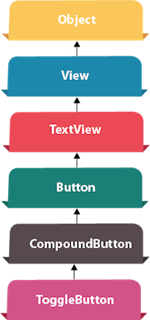

Slide 37
Android ToggleButton class
ToggleButton class provides the facility of creating the toggle button.
XML Attributes of ToggleButton class
The 3 XML attributes of ToggleButton class.
XML Attribute | Description
android:disabledAlpha | The alpha to apply to the indicator when disabled.
android:textOff | The text for the button when it is not checked.
android:textOn | The text for the button when it is checked.

Slide 38
Method | Description
CharSequence getTextOff() | Returns the text when button is not in the checked state.
CharSequence getTextOn() | Returns the text for when button is in the checked state.
void setChecked(boolean checked) | Changes the checked state of this button.
Methods of ToggleButton class
The widely used methods of ToggleButton class are given below.

Slide 39
Attributes of ToggleButton:
1. id: id is an attribute used to uniquely identify a toggle button.
<ToggleButton android:id="@+id/simpleToggleButton" android:layout_width="wrap_content" android:layout_height="wrap_content"/>

Slide 40
2. checked: checked is an attribute of toggle button used to set the current state of a toggle button. The value should be true or false where true shows the checked state and false shows unchecked state of a toggle button. The default value of checked attribute is false. We can also set the current state programmatically.
Below we set true value for checked attribute sets the current state to checked.
<ToggleButton android:id="@+id/simpleToggleButton" android:layout_width="wrap_content" android:layout_height="wrap_content" android:checked="true" /><!-- set the current state of the toggle button-->

Slide 41
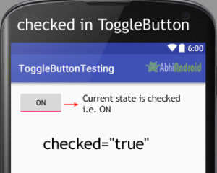

Slide 42
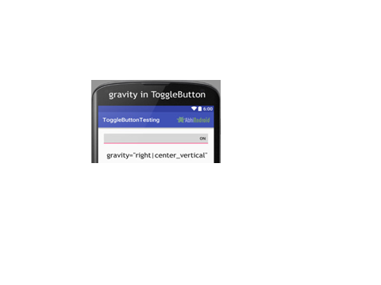
3. gravity: The gravity attribute is an optional attribute which is used to control the alignment of the text in ToogleButton like left, right, center, top, bottom, center_vertical, center_horizontal etc.
<ToggleButton android:id="@+id/simpleToggleButton" android:layout_width="fill_parent" android:layout_height="wrap_content" android:layout_centerHorizontal="true" android:checked="true" android:gravity="right|center_vertical"/><!-- gravity of the toggle button-->

Slide 43
textOn And textOff: textOn attribute is used to set the text when toggle button is in checked/on state. We can set the textOn in XML as well as in the java class.
Below is the example code with explanation included in which we set the textOn “Enabble Attribute Of Toggle button” for a toggle button.
<ToggleButton android:id="@+id/simpleToggleButton" android:layout_width="wrap_content" android:layout_height="wrap_content" android:checked="true" android:layout_centerHorizontal="true" android:textOff="Disable" android:textOn="Enable"/> <!--text to be displayed whenever toggle button is checked-->

Slide 44
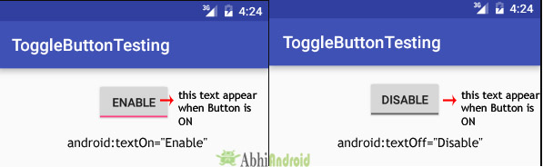

Slide 45
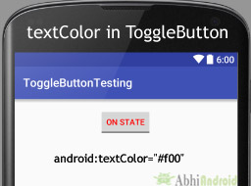
textColor: textColor attribute is used to set the text color of a toggle button. Color value is in the form of “#argb”, “#rgb”, “#rrggbb”, or “#aarrggbb”.
Below we set the red color for the displayed text of a Toggle button.
<ToggleButton
android:id="@+id/simpleToggleButton" android:layout_width="wrap_content" android:layout_height="wrap_content"
android:checked="false"
android:textOff="On State"
android:textOn="Off State"
android:layout_centerHorizontal="true"
android:textColor="#f00" /><!--red color for displayed text-->

Slide 46
textColor: textColor attribute is used to set the text color of a toggle button. Color value is in the form of “#argb”, “#rgb”, “#rrggbb”, or “#aarrggbb”.
textSize: textSize attribute set the size of the text of a toggle button. We can set the text size in sp(scale independent pixel) or dp(density pixel).
textStyle: textStyle attribute is used to set the text style of the text of a Toggle button. You can set bold, italic and normal. If you need to use two or more styles for a text view then “|” operator is used for that.
background: background attribute is used to set the background of a toggle button. We can set a color or a drawable in the background of a toggle button.

Slide 47
padding: padding attribute is used to set the padding from left, right, top or bottom.
paddingRight :set the padding from the right side of the toggle button.
paddingLeft :set the padding from the left side of the toggle button.
paddingTop :set the padding from the top side of the toggle button.
paddingBottom :set the padding from the bottom side of the toggle button.
Padding :set the padding from the all side’s of the toggle button.

Slide 48
drawableBottom, drawableTop, drawableRight And drawableLeft: These attribute draw the drawable below, top, right and left of the text of ToggleButton.

